Slide 1



SPI-UART BRIDGE
Giannis reinos | Dimitris tsalapatas
13-03-2023

Slide 2
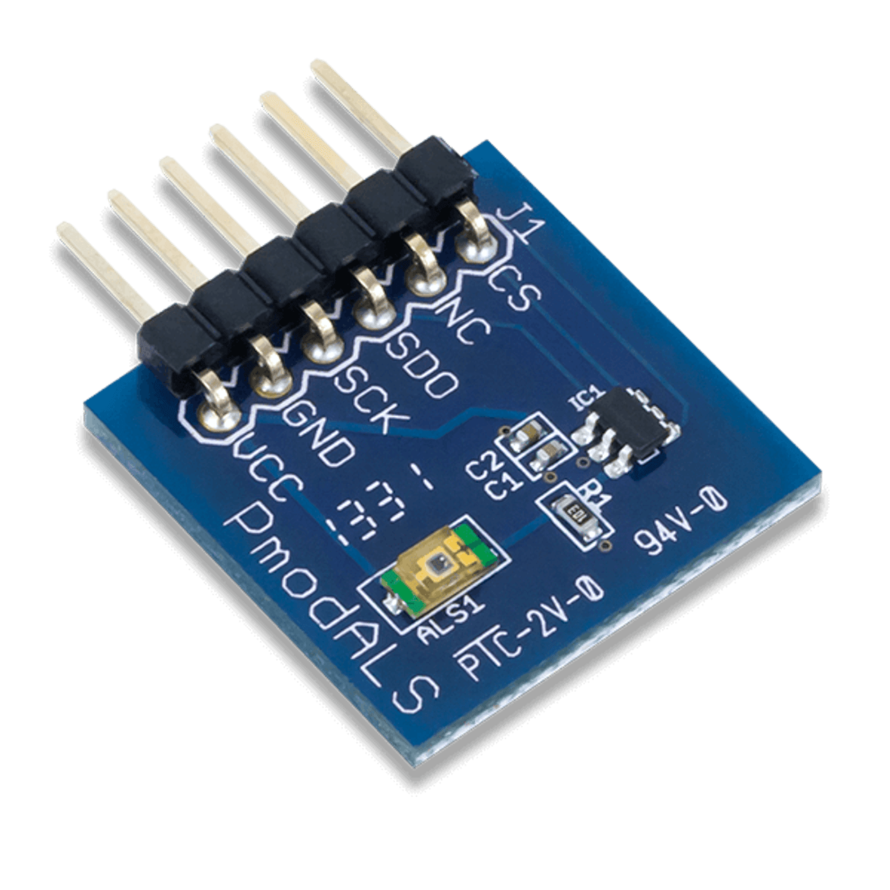
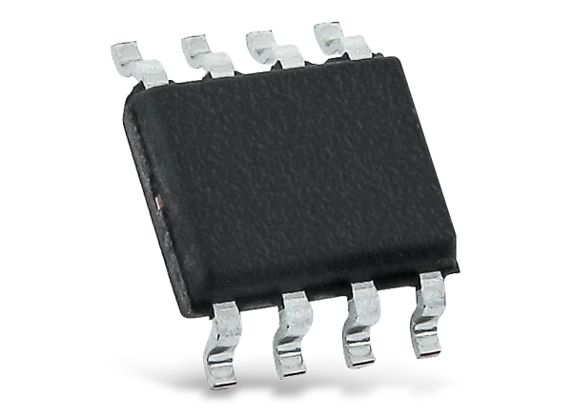

DESIGN APPLICATIONS
The purpose of the chip is to collect data from a digital sensor via Serial Peripheral Interface (SPI) and transmit the raw data via UART to an external UART port.
The chip is likely to have a compact size and low power consumption, making it suitable for various applications such as data logging, industrial automation, and environmental monitoring.

Slide 3
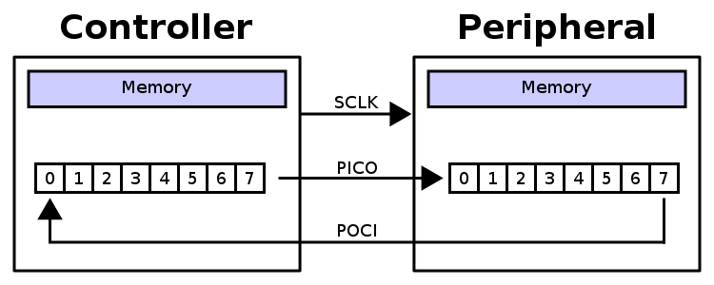
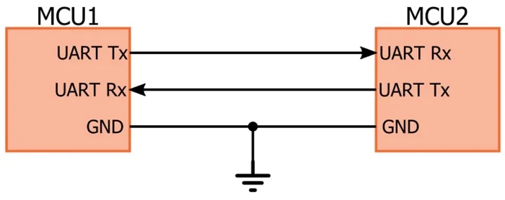
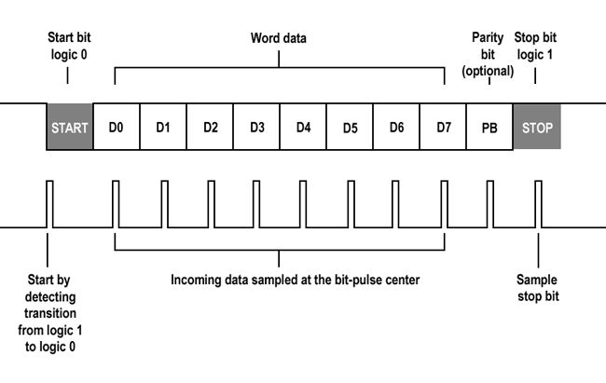
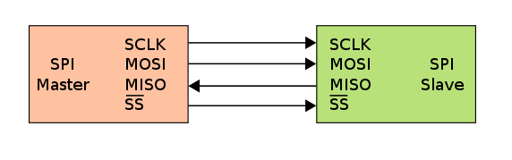
PROTOCOLS DESCRIPTION
SPI
UART

Slide 4
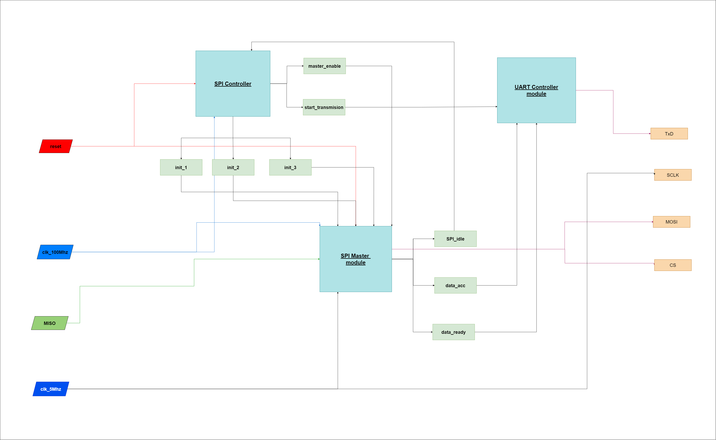
DESIGN DATAFLOW

